Slide 1
Winter 2024 Capstone Project
Free Library of Philadelphia – Parkway Central Library
Edwin A. Fleisher Collection of Orchestral Music
Henry S. Drinker Collection of Choral Music

Slide 2
Collection Background
Edwin A. Fleisher Collection
Edwin A. Fleisher (1877-1959)
Philanthropist, Little Symphony Club
1929 donation and endowment to Free Library (3,300 titles)
1934-1943 WPA Music Copying Project
Largest orchestral lending library in world
22,000 titles
Henry S. Drinker Collection
Henry S. Drinker (1880-1965)
Lawyer, amateur musicologist
1938 founded choral library
900+ titles; 20,000 items
Von Trapp family connection
Temporarily closed

Slide 3
Drinker Relocation Project
December 31, then February 5 deadline
Nathan = lead
Assisted with steps 1 and 3
1683 titles (not including Bach cantatas)
Metadata → Cataloging Dept → future circulation
1. Inventory and weed Drinker
2. Move Drinker scores to ROC
3. Move Bach cantatas to Music Dept
4. Install compact shelving in Drinker
5. Move Fleisher scores to Drinker
6. Install HVAC in Fleisher

Slide 4
Drinker Project – Lessons Learned
Regular maintenance of non-circulating collections
Realistic project timelines
Single items curse

Slide 5
Fleisher Correspondences Project
Scans already done
Goal = steps 2 and 3
Main file and WPA file
1300 files
Beatrix Potter example
No go on ArchivesSpace
Framework and groundwork for future
Internal reference document
Main file and Greatest hits document
1. Scan correspondences
2. Create descriptive metadata
3. Create finding aids using ArchivesSpace

Slide 6
Results
Just spreadsheets for now…

Slide 7
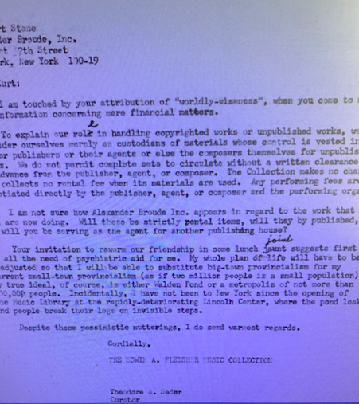
Example Correspondence
From, to, date
Main thrust of letter
Keywords
FLC works noted
Golden age of typewriters and snail mail

Slide 8
Next Steps
While waiting on ArchivesSpace…
1. WPA spreadsheet
2. Controlled vocabulary (internal, LCSH, LCNAF, MLA)

Slide 9
Fleisher Project – Lessons learned
'Needs to happen’ v. ‘nice to have’
Have software ‘in your hands’
Public library pace and timelines
Consistency is a challenge; ctrl f, c, v are your friends

